Slide 1

Unveiling Tropes: GA Capstone Project Presentation on Text Analysis and Trope Detection
By: Chan Zheng Yang Ivan
Date: 9 November 2023
Affiliation: General Assembly
Course: DSI-39

Slide 2
Introduction
Brief Overview: Welcome to my capstone project presentation. Today, I'll be discussing my work on analyzing and detecting tropes in text.
Agenda:
Definition Used
Problem Statement
Results and Findings
Tool Description
Applications
Future Enhancements
Questions

Slide 3
TV Tropes Definition
TV Tropes: A Compendium of Recurring Narrative Elements/A wiki website collecting common storytelling elements
Founded in 2004 by Anthony "Ant" Wandtke and Michael "Mike" Drew
Valuable resource for writers, filmmakers, and fans
Trope: A repository of recurring storytelling elements in fiction
Examples: Hero's Journey, Chekhov's Gun, Coming of Age Story
Tropes can enhance or hinder storytelling
Skillful use empowers compelling narratives

Slide 4
Problem Statement
Problem Statement
Identifying tropes in creative works is time-consuming and challenging.
Writers, filmmakers, and storytellers struggle to use tropes effectively and avoid clichés.
Fans of popular culture find it difficult to understand the tropes in their favorite stories.
Solution: A trope scanner automates trope identification, saving time and enhancing storytelling.
Applications:
Writers use it for inspiration.
Filmmakers avoid clichés.
Fans explore the history and significance of tropes.
Notes:
Identifying tropes in creative works can be time-consuming, posing challenges for writers, filmmakers, and storytellers. It's also a hurdle for fans of popular culture trying to understand their favorite stories.
A trope scanner is the solution. It automates trope identification, saving time for creators and enhancing story originality. For fans, it's a tool to dive deeper into their favorite stories.
Examples of trope scanner applications:
Writers use it to identify tropes effectively, like the Hero's Journey, for inspiration.
Filmmakers avoid clichés, such as Deus ex Machina, in their work.
Enthusiastic fans explore the history and significance of tropes, like the Secret Identity trope in superhero movies.

Slide 5
Methodology
Introduction to Development Methodology. We'll walk through the tool's creation in the next 4 slides.
Notes:
In this section, we will delve into the methodology behind the creation of our trope-scanning tool. Understanding how the tool was developed is crucial to appreciating its capabilities and potential. Over the next few slides, we'll take a comprehensive look at the process.

Slide 6
Data Collection
Media sources used:
Full episode summary: https://simpsons.fandom.com/wiki/Season_1
Trope source: https://tvtropes.org/pmwiki/pmwiki.php/Recap/TheSimpsons (Only Season 1 episodes used)
Reason for Choice: Extensive data, well-maintained wiki, comprehensive trope definitions
Notes:
The Simpsons, a long-running and well-documented television series, served as the primary data source for developing the trope scanner. The show's extensive history, spanning over three decades, provided a rich corpus of text for training and testing the model. Additionally, the availability of a well-maintained wiki, Simpsons Wiki, ensured access to comprehensive episode summaries and detailed character information. Tv Tropes, a comprehensive database of tropes, provided a rich source of trope definitions and examples, facilitating the identification and classification of tropes within the text.

Slide 7
Trope selected
Extract tropes from selected recap pages
Do tally of tropes
Pick 10 most occurring tropes

Slide 8
Tool Development
Provide an overview of the tools, technologies, and algorithms used to build the trope-scanning tool.
Highlight the key steps involved in developing the tool.

Slide 9
Evaluation
If applicable, discuss how you evaluated the effectiveness or accuracy of the tool.
Share any results or findings from the evaluation process.

Slide 10
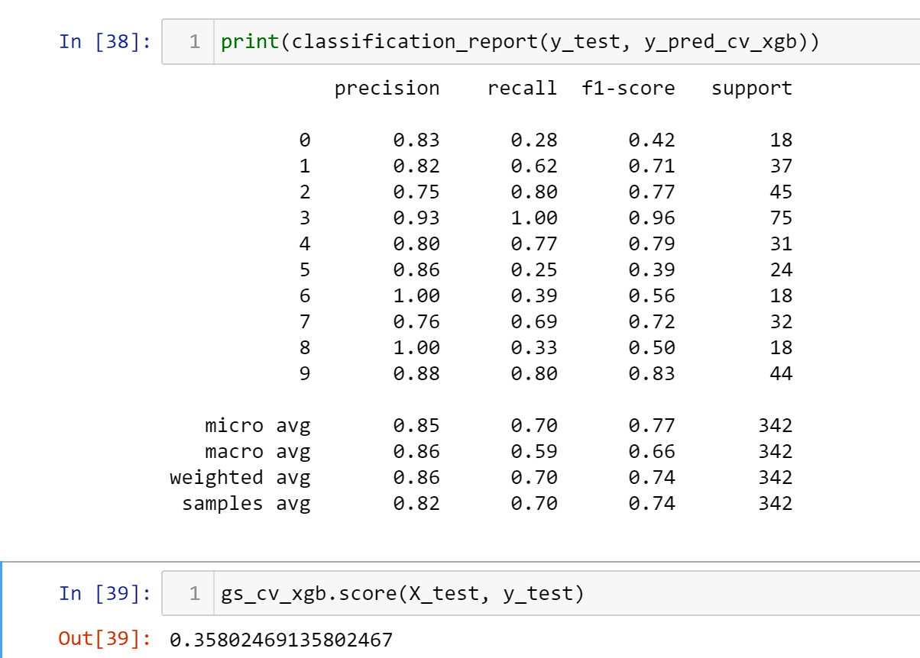
Results and Findings
Notes:
Considering this is the very first model of its existence, it’s understandable why the model is so low.

Slide 11
Tool Description
Key Features:
Identify tropes in written text
Analyze trope usage and significance
Compare tropes across different media
Visualize trope distribution for deeper insights
Ease of Use:
Intuitive interface for seamless navigation
Simple input methods for various media formats
Interactive visualizations for enhanced understanding

Slide 12
Functionality
REMEMBER TO PUT THE QR CODE HERE
Input media here
Let model scan
Return list of tropes
Notes:
How to use the machine:
Copy the passage you want to find tropes from.
The model will scan and determine from its dataset what tropes are likely to be inside your passage.
You get a list of tropes and the attached text that made the model believe that text is why the trope is present.

Slide 13
Applications
A screenwriter struggling with a new script can use the tool to identify overused tropes and explore alternative narrative approaches.
A novelist researching a historical novel can use the tool to identify tropes commonly used in works of historical fiction, ensuring historical accuracy and genre conventions.
A film director preparing to adapt a book into a movie can use the tool to analyze the book's tropes and plan how to translate them effectively into a visual medium.
A fan of a popular TV show can use the tool to identify the show's recurring tropes, gain a deeper appreciation for the show's storytelling, and connect with other fans who enjoy similar tropes.

Slide 14
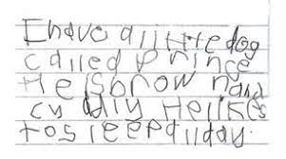

Future Enhancements (Part 1)
Current Limitations:
Language Barrier (She is learning to play the piano)
Structured Text Focus
她正在学习弹钢琴。
ERROR! Text error!
Notes:
Language Barrier: Currently, the tool is limited to analyzing English-language input, restricting its accessibility to a wider audience.
Structured Text Focus: The tool is primarily designed for structured text-based media source (such as wiki transcripts and summaries), such as scripts and novels, limiting its application to other forms of media.

Slide 15

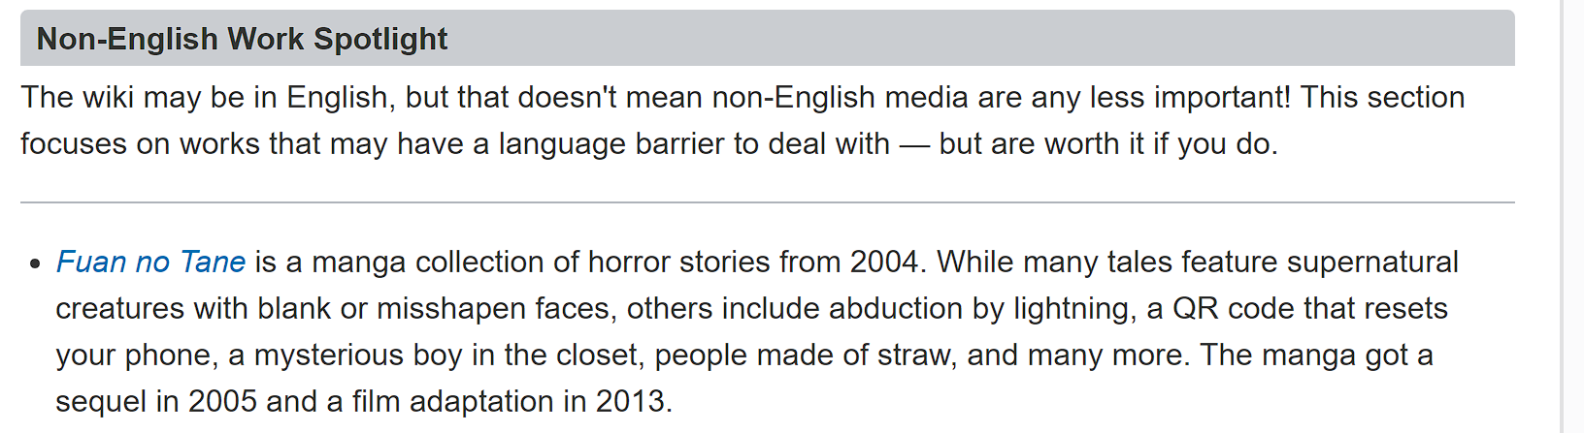
Future Enhancements (Part 2)
Internationalization: Recognize the importance of internationalization.
Global Trope Recognition
Bridging Linguistic and Cultural Gaps
Notes:
Global Trope Recognition: TV Tropes, the underlying knowledge base for the tool, already encompasses non-English media, demonstrating the global relevance of tropes.
Bridging Linguistic and Cultural Gaps: Expanding the tool's analysis capabilities to a broader international audience holds the potential to bridge language and cultural barriers, fostering a more inclusive understanding of tropes.

Slide 16

Future Enhancements (Part 3)
Expansion Plans:
Non-Structured Text Media Support
Audio Analysis Integration
Image Recognition Functionality
Video Media Inclusion
Notes:
Non-Structured Text Media Support: Enhancing the tool's versatility by enabling support for non-structured text media, such as blog posts and social media content, will broaden its applicability.
Audio Analysis Integration: Exploring the incorporation of audio content, including podcasts and dialogues, into the tool's analysis will provide a deeper understanding of trope usage in auditory mediums.
Image Recognition Functionality: Extending the tool's functionality to analyze images will allow for the identification of tropes within visual elements, recognizing that a single image can convey multiple narrative devices.
Video Media Inclusion: Aiming to include video media analysis will provide a comprehensive trope-scanning experience across various forms of media. (Such as YouTubers who do What-Ifs with no existing wiki for them)

Slide 17
Future Enhancements (Part 1)
Current Limitations:
Language Barrier: Currently, the tool is limited to analyzing English-language input, restricting its accessibility to a wider audience.
Structured Text Focus: The tool is primarily designed for structured text-based media source (such as wiki transcripts and summaries), such as scripts and novels, limiting its application to other forms of media.
Internationalization: Recognize the importance of internationalization.
Global Trope Recognition: TV Tropes, the underlying knowledge base for the tool, already encompasses non-English media, demonstrating the global relevance of tropes.
Bridging Linguistic and Cultural Gaps: Expanding the tool's analysis capabilities to a broader international audience holds the potential to bridge language and cultural barriers, fostering a more inclusive understanding of tropes.
Expansion Plans:
Non-Structured Text Media Support: Enhancing the tool's versatility by enabling support for non-structured text media, such as blog posts and social media content, will broaden its applicability.
Audio Analysis Integration: Exploring the incorporation of audio content, including podcasts and dialogues, into the tool's analysis will provide a deeper understanding of trope usage in auditory mediums.
Image Recognition Functionality: Extending the tool's functionality to analyze images will allow for the identification of tropes within visual elements, recognizing that a single image can convey multiple narrative devices.
Video Media Inclusion: Aiming to include video media analysis will provide a comprehensive trope-scanning experience across various forms of media. (Such as YouTubers who do What-Ifs with no existing wiki for them)

Slide 18
What needs to be edited
Methodology: Describe the approach, techniques, and tools you used to develop your trope-scanning tool. Explain the steps you took to build the tool and how it works. Use 4-5 slides for this section.
Data Collection: Discuss the sources of data you used for your project and the data collection process. Explain how you prepared the data for analysis. Use 2-3 slides for this section.
Tool Description: Present the key features and functionality of your trope-scanning tool. Use screenshots or diagrams to illustrate how it works. Use 3-4 slides for this section.
Results and Findings: Share the results of using your tool on sample texts. Present statistics, visualizations, or examples of identified tropes. Use 3-4 slides for this section.
Applications: Discuss the practical applications of your tool. How can it be used, and in what contexts? Use 2-3 slides for this section.
Future Enhancements: Outline potential future improvements or research directions for your tool or similar projects. Use 2-3 slides for this section.
Questions (Slide): Insert a slide that invites questions from the audience for the Q&A session.

